Slide 1

Hello, Ionut sunt eu ☺

Slide 2
Web Application Testing www.investing.com Smart Decision Making

Slide 3
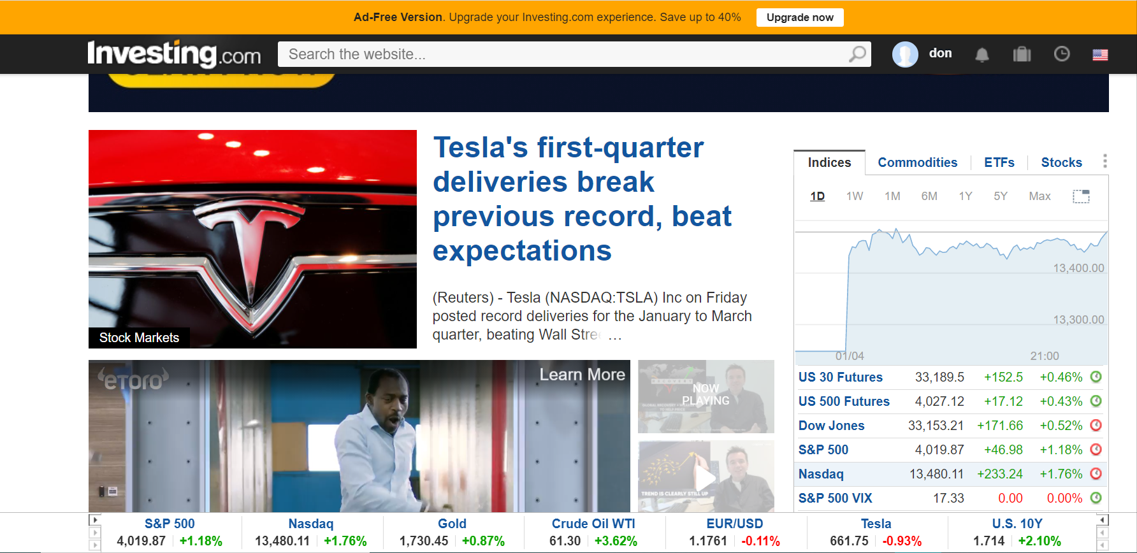
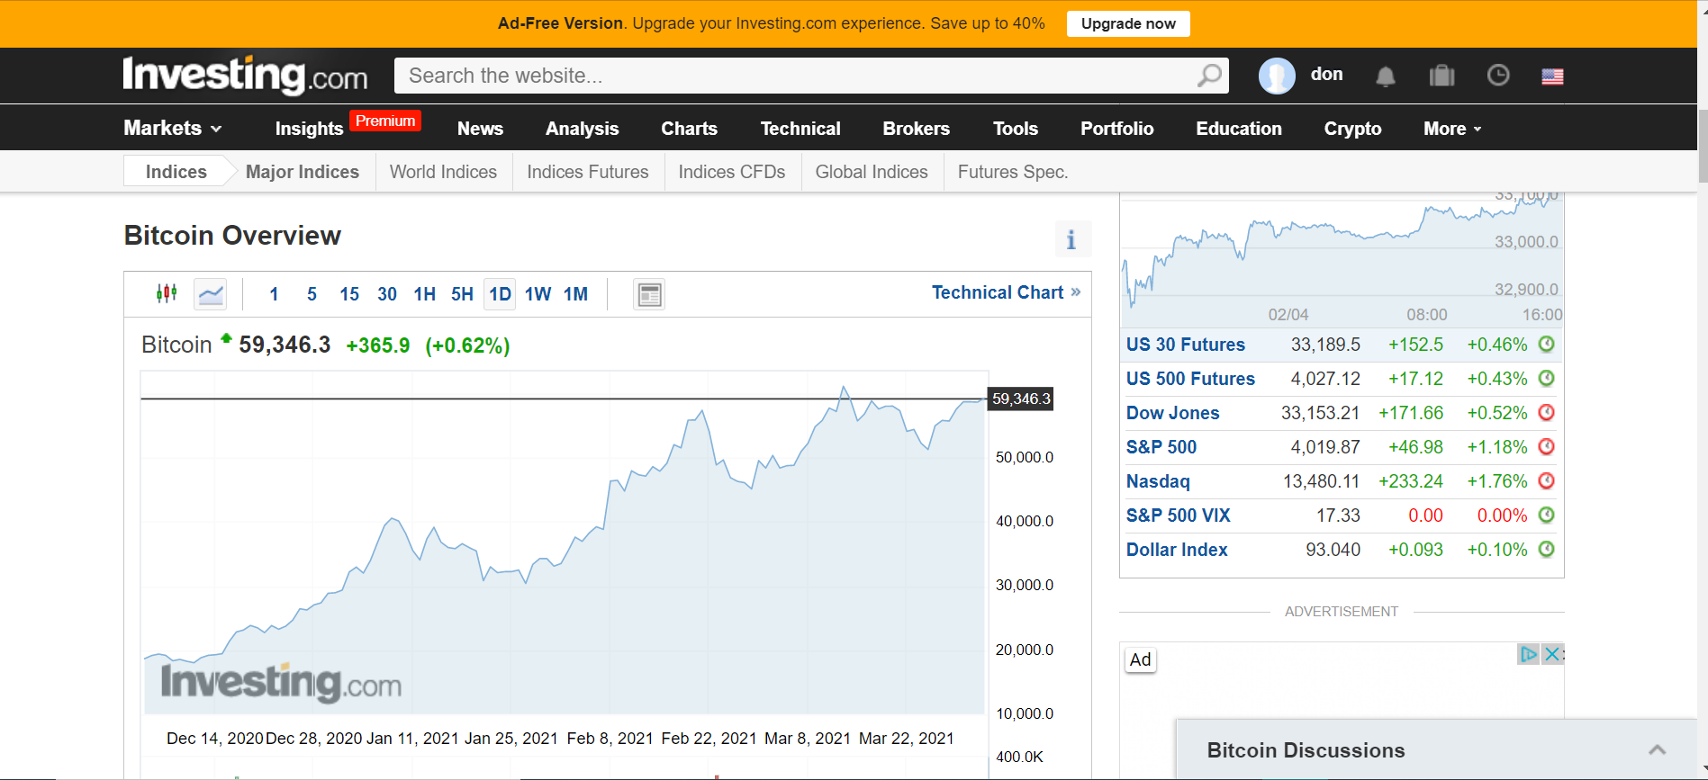
Visual Sample of the website.

Slide 4
About www.investing.com
-Financial Markets Platform;
-Premium Insights subscription option;
-Real time providing financial-tools,
charts, breaking news, quotas;
-250 exchanges arround the world;
-More than 30 languages option;

Slide 5
Investing made easy
News
Graphs
Decisions

Slide 6
“A picture is worth a thousand
words. ”

Slide 7

Testing Aproach
Write Smoke tests and execute them;
Exploratory testing for main functionalities;
Focus where bugs were identified, more testing on that area;
Logged the bugs;
Write the test report.

Slide 8

Testing Types
www.investing.com
Functional
Non-Functional
Security Testing
Positive testing
Exploratory testing
Performance Testing
Negative Testing
Smoke testing
UI Testing

Slide 9
Smoke Tests Overview
Registration/Signup
Search Bar
Tools/Converter
Premium Account
Login
Portofolio
Stocks/Screener
Education

Slide 10
Test Cases Results. (Functional)
Functionality | Total | Pass | Failed | Blocked | Not Run | Defects
Registration Automated (A) | 7 1 (A) | 7 | 0 | 0 | 1 (A) | 0
Login Automated (A) | 5 2 (A) | 5 2 (A) | 0 | 0 | 0 | 0
Premium Account | 1 | 0 | 0 | 0 | 1 | 0
Search Bar Automated (A) | 5 2 (A) | 5 2(A) | 0 | 0 | 0 | 0
Stock/Screener | 2 | 1 | 1 | 0 | 0 | 2 (Attached)
Tools/Converter | 1 | 1 | 0 | 0 | 0 | 0
Portofolio | 1 | 1 | 0 | 0 | 0 | 0
Education | 1 | 1 | 0 | 0 | 0 | 0
Forgot Password | 3 | 3 | 0 | 0 | 0 | 0
Total | 31 | 28 | 1 | 0 | 2 | 2

Slide 11
Total test cases.

Slide 12
Test Cases Results.(Non-Functional).

Slide 13

Conclusions
- 31 Test cases executed to test happy flows;
- 5 Test Cases Automated with Cypres.
-28 passed;
- 3 failed : Registration (A), Premium Account (A), Stocks Sorting.
- 6 Test cases executed to test non-functional;
- 2 Test cases for non-fuctional automated with Postaman;
- 2 Defects (bugs) found.Attached file;
-Defects found doing black box testing, exploratory;
- Data type used: Valid, Invalid, Blank;

Slide 14
Leassons learned.
Challenges
News Flash
Keep the TC steps and results easy to follow
Lack of requirements
😉
Less is more,
Simple steps are better to use for writing Tc and reporting bugs
Exploratory testing
facilitates
Learning of
Functionalities

Slide 15
😉
Well…
Thank you.
💣

